Slide 1
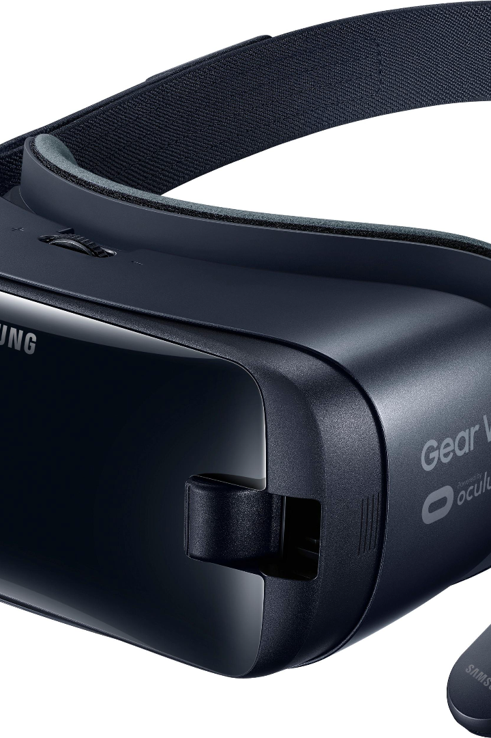
Introduction to Virtual Reality
Virtual reality is an immersive technology that enables you to experience an alternate reality. It has come a long way in recent years, opening up new possibilities for gaming, education, and more.
by PRIYANSHU KAMBLE

Slide 2
History of Virtual Reality
1
The first head-mounted display
Developed in 1968 by Ivan Sutherland, this bulky device was too heavy to wear on your head.
The 90s VR craze
2
In the early 90s, virtual reality became a hot topic in the media with the introduction of Sega VR and Nintendo Virtual Boy.
3
Present day
Easy-to-use and affordable VR devices are now accessible, such as Oculus, Vive and PlayStation VR.

Slide 3

Types of Virtual Reality Experiences
Exploration
Simulation
Experience the depths of the ocean or explore exotic locations from the comfort of your home.
Add excitement to your day with virtual reality simulations, such as rides, rollercoasters or skydiving.
Gaming
Education
Immerse yourself in worlds that stretch your imagination, interact in fun virtual experiences with your friends!
Virtual reality provides a unique medium for educational simulations and skill practice; for example, surgeons or military and flight training.

Slide 4

Applications of Virtual Reality
1
Healthcare
2
Construction and Architecture
Treat mental illness, socially awkward, physical pain speech disorder and assistive communication tools.
Imagine buildings before they are constructed and explore them in a virtual 3d space; you can also attract buyers for new building designs.
3
Tourism
4
Marketing and Advertising
Visualize and explore places before booking trips and vacations.
Showcase products or promotional materials in an interactive and immersive way!

Slide 5
Advantages and Disadvantages of Virtual Reality
Advantages
Disadvantages
Immersive and engaging experience
Can cause physical discomfort such as headaches, nausea or dizziness
Innovative medium for simulation, therapy, marketing, and education
Expensive hardware
Ability to interact with virtual objects or simulations
Requires powerful computing resources

Slide 6
Future Trends in Virtual Reality Technology
Wireless Headsets
5G Integration
More freedom of movement and less required hardware may encourage more usage of virtual reality devices.
Virtual reality experiences may benefit from a faster internet to support smooth streaming of high-quality content.
Augmented Reality
Virtual Reality Conferences
A blend between virtual and physical reality, AR may revolutionise the way we interact with our surroundings.
With remote work becoming the norm, an immersive conference experience will become more valuable.

Slide 7



Conclusion and Key Takeaways
Virtual reality is an exciting and growing field with numerous benefits and possibilities. Its primary disadvantage is its cost and hardware requirements. However, advances in technology and innovations in industry mean it's more accessible than ever before. Lastly, virtual reality technology will continue to advance, and the future look bright for this fascinating field!

